Slide 1



Design Patterns

Slide 2

What Design Patterns are
Reusable blueprints for software development.
A place to start at when solving a well known software interaction
A structure for thinking about how to develop a large software system
Filled with tradeoffs and answers that involve “it depends”

Slide 3



What Design Patterns are not
A one size fits all solutions to a particular problem
A solution for the details of your problem
Blocks and pieces that, when composed exactly right, can solve all software problems

Slide 4

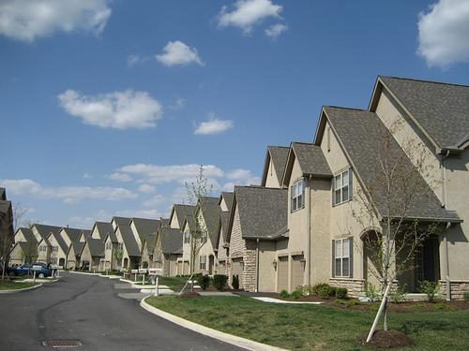
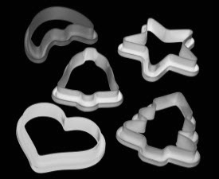
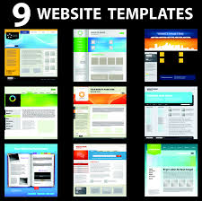
Patterns in the world around us

Slide 5
Why are design patterns so important?

Slide 6

Useful Abstractions
Coding to an interface, along with all their advantages
Maximize Reuse
Code is modular
Minimizing Maintenance
Reused code creates a single reference
Maximize Extensibility
Easy to add features without changing what’s already there

Slide 7
What do I need to implement a design pattern?
Encapsulation - Objects encapsulate, or contain, data and procedures
Inheritance/Interfacing - Multiple objects can be used and referenced interchangeably
Polymorphism - Dynamic binding of requests to objects based on run-time type
Composition - Objects are composed, or formed together into a single object, to create new functionality
“Program to an interface, not an implementation”
-- Erich Gamma, Richard Helm, Ralph Johnson, John Vlissides

Slide 8
Class Inheritance
Type
Subtype
Professors
Students
People at UCR

Slide 9
Type hierarchy
UCR_person contains:
Common data members
Name
ID
Address
Common methods
Change_address
display
UCR_person
UCR_professor
UCR_student

Slide 10
Type hierarchy
UCR_professor inherits the data members and methods from UCR_person. Then UCR_professor extends UCR_person:
Specific data members
Salary
Rank
Specific methods
add_class
change_rank
UCR_person
UCR_professor
UCR_student

Slide 11
Type hierarchy
UCR_student inherits the data members and methods from UCR_person. Then UCR_student extends UCR_person:
Specific data members
major
Classes taken
year
Specific methods
change_major
change_course
UCR_person
UCR_professor
UCR_student

Slide 12

Inheritance and Polymorphism in C++

Slide 13
C++ Access Control
Public:
Private:
Protected:
Accessible by anyone
Accessible only inside the class, NOT by subclasses
Accessible inside the class and from all subclasses

Slide 14
Polymorphism
Class UCR_person { private: string name; string address; int ID; public: UCR_person(int,string, string); virtual void display() { cout << name << “\n” << ID << “\n” << address << endl; } }; | Class UCR_professor : public UCR_person { private: int salary; string rank; public: void display() { UCR_person::display(); cout << rank << “\n” << salary << endl; } };
UCR_person* prof = new UCR_professor(1,”Jeff McDaniel”,); prof->display(); | Declared type: UCR_person Actual (resolved) type: UCR_professor
Note: Professor Constructor uses the constructor of the supertype (person):
UCR_professor(int id, string name, string addr, int salary, string rank) : UCR_person(id,name, addr) { … }

Slide 15
Abstract Base Class
When it doesn’t make sense to have an object of that class
In C++ use pure virtual functions; virtual functions without implementation in the base class
class UCR_person {
public:
virtual void display() = 0;
}
Indicates that display is pure (no implementation)
Display is declared virtual
UCR_person can no longer be instantiated

Slide 16
Inheritance vs. Object Composition
Inheritance is considered white-box reuse
Internals of parent class are visible to children
Redesign of parent causes redesign of children classes
Statically determined at compile time
Object composition is black-box reuse
Internals of object in the composition are hidden from other objects
Redesign of internals of an object don’t require redesign of other objects
Redesign of interface of an object requires redesign of other objects
Dynamically determined at run-time

Slide 17


What is a design pattern?
A DESIGN PATTERN SYSTEMATICALLY NAMES, EXPLAINS, AND EVALUATES AN IMPORTANT AND RECURRING DESIGN IN OBJECT-ORIENTED SYSTEMS
DESIGN PATTERNS HELP A DESIGNER GET A DESIGN “RIGHT” FASTER.

Slide 18
Describing design patterns (Example)
Pattern Name
Problem (Intent)
Solution (Structure/Participants)
Consequences
Composite
Code treats primitive and container objects differently, even if the user treats them similarly
An abstract class that represents both primitives and containers with the same interface
Consequences
Makes the client simple
Defines class hierarchies
Makes adding new components easy

Slide 19
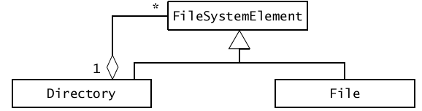
Structure of design patterns (Example)

Slide 20
Design Pattern Classification
Purpose
Creational
Concerned with object creation
Structural
Composition of classes or objects
Behavioral
Characterize interactions of classes or objects
Scope
Class
Pattern applies primarily to classes
Object
Pattern applies primarily to objects
Notes:
Class patterns deal with relationships between classes and their subclasses, established through inheritance and so are static
Object patterns deal with object relationships which are more dynamic and can be altered during run-time
This merely describes the focus, most patterns will deal with both

Slide 21
Design Pattern Classification
 |  | Purpose
 |  | Creational | Structural | Behavioral
Scope | Class | Factory Method | Adapter (class) | Interpreter Template Method
 | Object | Abstract Factory Builder Prototype Singleton | Adapter (object) Bridge Composite Decorator Facade Flyweight Proxy | Chain of Responsibility Command Iterator Mediator Memento Observer State Strategy Visitor

Slide 22
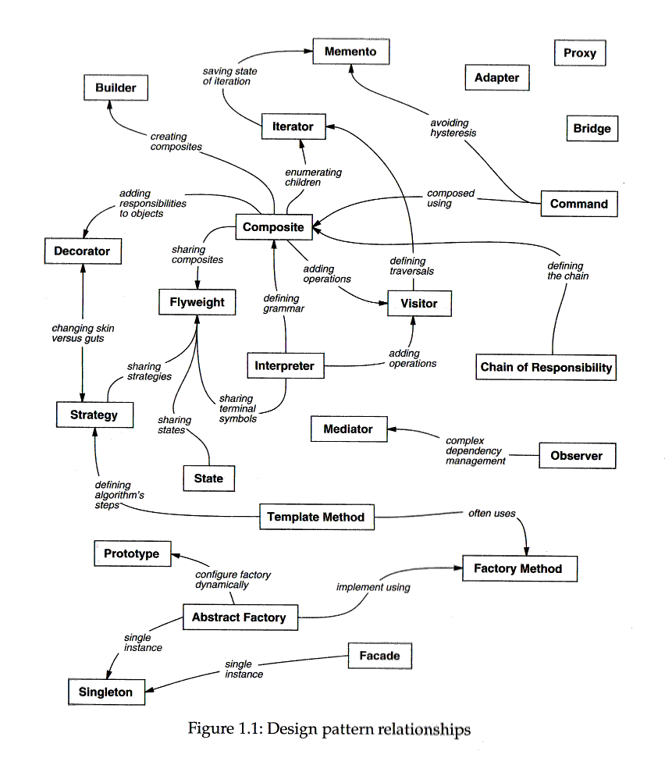
How to
select a
design pattern

Slide 23
How to select a design pattern?
Review the intent of the design pattern (Section 1.4.)
Review how the patterns relate to one another
Select a pattern or a group of patterns
Review patterns of similar purpose
What might cause you to redesign your system? ( page 24 )
What do you want to be easy to change in your system? (Table 1.2)

Slide 24
Course Patterns
Overview
Creational Patterns
Structural Patterns
Behavioral Patterns

